Slide 1
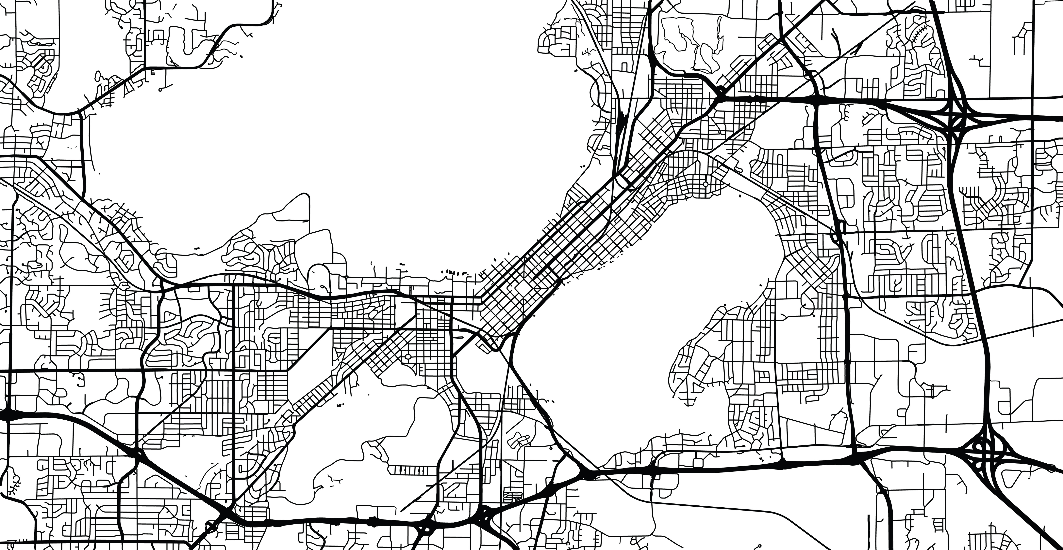
The Feasibility and Equity of
Geolocation Data for Lapse Prediction
in Alcohol Use Disorder (AUD)
Claire Punturieri
Department of Psychology
University of Wisconsin-Madison

Slide 2

Conclusions
Introduction
Methods
Results

Slide 3
Introduction
Background & Current Study

Slide 4


The current problem
29.5 million people diagnosed with alcohol use disorder (AUD) in 2022
Some individuals will experience “natural recovery”
Improvement without intervention
For others, AUD will present as a chronic, relapsing disorder
Periods of recovery interspersed with returns to harmful use
Jonathan et al., 2000; Kuhn & Johnson, 2018
Notes:
About 29.5 adults in the United States met diagnostic criteria for alcohol use disorder, or AUD, in 2022. That’s about 1 in 10 adults! Of these individuals, some will go on to experience what’s called “natural recovery”, or improvement without intervention. Their patterns of heavy or frequent drinking will resolve on their own. Yet for others, AUD will present as a chronic, relapsing disorder, marked by periods of recovery interspersed with returns back to harmful use.

Slide 5



Continued monitoring for recovery
Assist with maintenance of recovery goals
Help individuals identify precipitants to lapses, single instances of goal inconsistent use that may lead to relapse
How can we provide this in a way that is scalable and sustainable?
+
Personal sensing data
Machine learning
Notes:
For these individuals, continued monitoring may be beneficial in helping to maintain recovery goals as well as identify potential precipitants to lapse, which are single instances of goal inconsistent use that may lead to relapse.
But, how can we offer continued monitoring to people in a way that is both scalable and sustainable? One way we might be able to do this is by using both personal sensing data and machine learning.
Personal sensing data are data derived via embedded sensors in technology such as smartphones, smartwatches, or wearables. These devices are everywhere, and so one benefit of harnessing their data is that we already know that this type of data collection is unobtrusive and wouldn’t require individuals to change anything about their daily routines. This suggests that data could feasibly be collected long-term and will also be ecologically valid. When paired with machine learning models, statistical patterns connecting antecedents to lapse derived from these data (e.g., changes in mood, difficulty with close social connections, proximity to risky locations) to true lapse events can be uncovered. This is the foundation for the development of the model that I’ll be talking about today.

Slide 6
Data selection for risk monitoring
1) Capture fluidity of recovery, return to use
Ideal data type captures this dynamic process
2) Low burden data collection
Promote sustained engagement
Ideally, relieve some cognitive burden of recovery
3) Provide data that map onto theoretically-relevant constructs
Yield actionable intervention points
Notes:
So, personal sensing offers us a wealth of information – so how to we decide what type of data to narrow in on? There are three boxes we’re trying to check when picking a data source.
Recovery and return to use are dynamic processes. Factors that contribute both to maintenance of recovery and return to use change from person-to-person and from moment-to-moment. A shift in social supports (e.g., a move, a break-up) may precede a lapse for one individual but not another. Time spent in locations where alcohol is available (e.g., bars, restaurants, concert venues) may precede a given lapse for another individual, but will not necessarily precede future lapses in that same individual. In order to best capture this fluidity, the ideal data type used within continuous risk monitoring systems should be able to provide a correspondingly appropriate level of granularity.
We also want to make sure that we are selecting a data type that is low burden and promotes sustained engagement. We want people to be able to use this to monitor their recovery in the long-term, in line with the idea that this system should help people who will have a chronic, relapsing experience of AUD. Ideally, it should relieve some of the cognitive burden of recovery that comes with constant self-monitoring.
Finally, we want to get data that maps onto theoretically-relevant constructs! We want our data source to yield clinically actionable intervention points so that we are not only assessing someone’s risk levels but can eventually communicate to them how they might modify their behavior to promote sustained recovery.

Slide 7
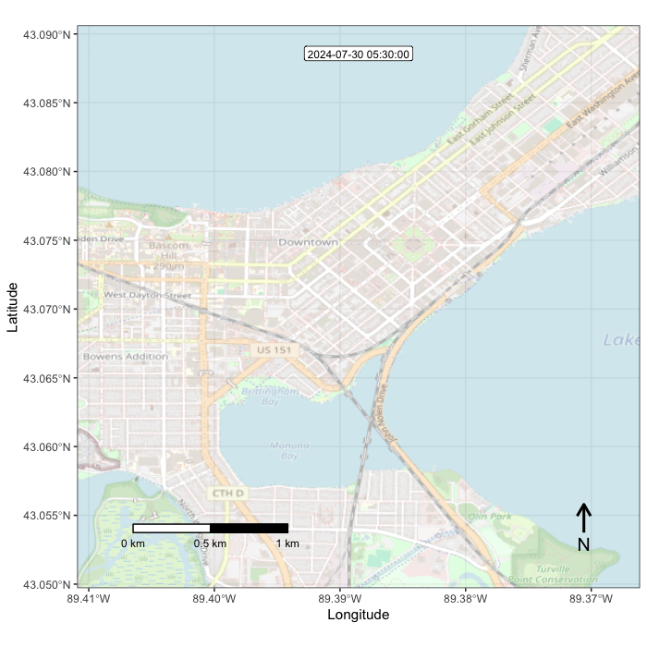
Geolocation data for risk monitoring
Latitude, longitude coordinates and timestamps
Can be sampled at regular intervals via smartphone applications
Many devices collect these data already!
Location proven to play an important role in lapse
High-risk situations as an immediate precursor to return-to-use in the relapse prevention model
Coping with substance-associated contexts in mindfulness-based relapse prevention
My data! Not participant data ☺
Notes:
One source that checks all of these boxes is geolocation data.
Geolocation data consist of latitude and longitude coordinates and timestamps and can be sampled at regular intervals, meaning they’re well-position to match the fluidity of recovery.
Moreover, these data are collected using applications on smartphones with little to no input from the user beyond initial set-up. Many smartphones and smartwatches automatically collect these data by default. So, they’re also low burden.
And finally, the importance of location, such as environmental cues or one’s perceived riskiness of a setting, has been shown to play an important role in lapse. For example, high-risk situations are conceptualized as an immediate precursor to relapse in the relapse prevention model.
This link with lapse risk has translated into the integration of coping skills that target substance-associated contexts in several treatment strategies like mindfulness-based relapse prevention. These findings underscore not only the potential wealth of information relating to lapse risk that an individual’s location can provide, but also demonstrate the proven integration of location information into treatment.

Slide 8


Past research using geolocation
In substance use literature:
Risky locations: neighborhood characteristics, physical proximity to bars
In affective science literature:
Mood: estimate and predict loneliness, isolation, quantify depressive symptoms
Integration across subfields in part accomplished through enriching geolocation data with brief, intermittent surveys probing specific information about frequently visited locations
Notes:
Within the substance use literature, geolocation data have historically been used to examine risky locations, such as the influence of neighborhood characteristics on use and individual physical proximity to locations of potential or past harmful use such as bars). Several of the applications implemented in these studies enable real-time notifications about locations to their users (e.g., a pop-up message on a smartphone which reads “You are entering a high-risk zone”).
On the other hand, affective scientists have focused instead more closely on factors relating to mood. Geolocation data have been used to estimate and predict loneliness, isolation, and depressive symptoms.
An integration across these subfields can be in part accomplished by enriching geolocation data with brief, intermittent surveys probing specific information about frequently visited locations. For example, some of the more nuanced facets captured within location are associations with others (or lack thereof, e.g., social isolation), associations with previous drinking behaviors (e.g., whether or not alcohol is present), and associations with affect (i.e., negative versus positive emotions tied to a given location).
Using a combination of these insights in building a model for use within a continuous risk monitoring system will result in the ability to identify a wider variety of potential lapse precipitants and, therefore, theoretically perform better across heterogenous experiences of recovery.

Slide 9
Model evaluation
Rigorous evaluation using performance metrics, testing on independent observations crucial prior to deployment as standard
Expand this to include fairness assessments
Is there preferential performance in our model with respect to inherent or acquired characteristics (e.g., sex at birth, race, socioeconomic status)?
Machine learning algorithms can help us understand statistical patterns in data, but can also unintentionally perpetuate patterns of inequities:
Can provide sub-optimal care to individuals who already face disadvantages
Lead to eroded trust and therefore lower use of these tools for those who may benefit the most
Notes:
Data selection, however, is only one component of the successful development of a continuous risk monitoring algorithm. It is imperative that these models be rigorously evaluated using performance metrics and eventually tested using independent observations (i.e., using the model to predict outcomes for individuals whose data were not used in development). This workflow in machine learning is what enables researchers to anticipate how well a model can be expected to generalize to new populations and is key when aiming to develop algorithms for real-world healthcare implementation.
Although performance metrics like model accuracy, for example, have been standard reporting practice for years, recent literature has begun to urge researchers to add assessments of how *fair* a model is. A fair algorithm is one with no preference in performance with respect to inherent or acquired characteristics (e.g., sex at birth, race, socioeconomic status]. In the context of a continuous risk monitoring algorithm for AUD, this would mean that lapse predictions are reasonably accurate and do not favor or disadvantage any particular group solely due to group membership status.
Machine learning algorithms can help us understand statistical patterns in data, but can also unintentionally perpetuate patterns of inequities:
Can provide sub-optimal care to individuals who already face disadvantages
Lead to eroded trust and therefore lower use of these tools for those who may benefit the most

Slide 10
Where are we now?
Models must be developed outright…
Need to perform well (i.e., pinpoint lapses accurately)
Identify meaningful, actionable precursors on which to intervene
…with the goal of equity in mind
Demonstrate similar performance across different people
Provide a sustainable method of data collection for users

Slide 11
The Current Study
Geolocation data collected from smartphones and corresponding self-reported contextual information for frequently visited locations were used to build a machine learning model to predict next-day alcohol use lapse among individuals with a diagnosis of AUD and a recovery goal of abstinence.

Slide 12
Methods
Measures & Analyses

Slide 13
Participants (N = 146)
Notes:
One hundred and forty six individuals in early-recovery (1-8 weeks of abstinence) for AUD were recruited from the Madison area to take part in a three-month study on how mobile health technology can provide recovery support (R01 AA024391).
Our sample was evenly split by sex, but was majority white and non-Hispanic. The average age of the final sample was 40.9 years (SD = 12 years, range = 21-72 years). The mean income of participants was $34,408 (SD = $32,259, range = $0-$200,000). On average, participants self-reported a mean number of 8.9 DSM-V symptoms of AUD (range = 4-11).

Slide 14

Procedure
Five in-person visits, 4x daily surveys, and continuous passive monitoring of geolocation data
Screening &
Enrollment
Follow-up #1
Follow-up #2
Follow-up #3
ONE MONTH
ONE MONTH
ONE MONTH
Survey and geolocation data continuously collected throughout this period
Screening and enrollment:
Demographic and alcohol use-related information
Pre-reported frequently visited locations
Follow-up visits:
Asked contextual questions about frequently visited locations in past month (>2 times)
Notes:
As part of participating in the study, participants completed five in-person visits, daily surveys, and continuous passive monitoring of geolocation data.
During the enrollment period, participants provided information about their demographics and alcohol use. They also pre-reported known frequently visited locations.
Following this, daily surveys and geolocation data tracking began and participants completed three follow-up visits one month apart.
At each visit, participants were asked contextual questions about frequently visited (\>2 times during the course of the previous month) locations.

Slide 15
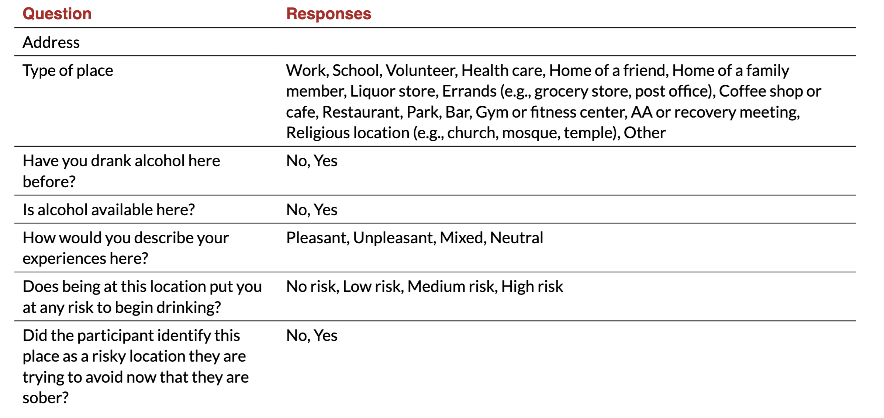
Contextual information
Notes:
Contextual information for frequently visited locations (\>2 times in the previous month) was obtained during an interview at each follow-up visit (at month 1, 2, and 3; Table 2).

Slide 16


Geolocation data
Moves
FollowMee
Collected via Moves and FollowMee
Tracked using GPS and WiFi positioning technology
Data were processed to filter out:
Duplicated points
Fast movement speeds (> 100mph)
Sudden positional jumps
Long-duration sampling periods (> 24h no movement or > 2h with position jump > .31 miles)
Points “in transit” if > 4mph
At known context if within .031 miles of location

Slide 17

Lapses
Next-day lapse occurrence predicted in 24-hour windows
Windows are from 4:00am – 4:00am
previously collected data
4:00am
6:00am
6:00pm
4:00am
6:00am
12:00am
12:00pm
12:00am
Notes:
Again, alcohol lapses were used as our outcome variable in this study and were used to provide labels for model training, for testing model performance, and for testing issues of algorithmic fairness. Future lapse occurrence (here conceptualized as next-day lapse) will be predicted across 24-hour windows, from 4:00am-4:00am. Each prediction used all of the previously collected geolocation data up until that point.
*Lapse* and *no lapse* occurrences were identified from the daily survey question, *"Have you drank any alcohol that you have not yet reported?"*. Participants who responded *yes* to this question were then asked to report the date and hour of the start and the end of the drinking episode. In this case, the prediction window will be labeled *lapse*. Prediction windows will be labeled *no lapse* if no alcohol use was reported within that window.

Slide 18
Lapses
Next-day lapse occurrence predicted in 24-hour windows
previously collected data
4:00am
6:00am
6:00pm
4:00am
6:00am
12:00am
12:00pm
12:00am
Lapse and no lapse occurrences identified from daily survey question, “Have you drank any alcohol that you have not yet reported?”
Participants who responded yes to this question were then asked to report date and hour of start and end of drinking episode
Notes:
Again, alcohol lapses were used as our outcome variable in this study and were used to provide labels for model training, for testing model performance, and for testing issues of algorithmic fairness. Future lapse occurrence (here conceptualized as next-day lapse) will be predicted across 24-hour windows, from 4:00am-4:00am. Each prediction used all of the previously collected geolocation data up until that point.
*Lapse* and *no lapse* occurrences were identified from the daily survey question, *"Have you drank any alcohol that you have not yet reported?"*. Participants who responded *yes* to this question were then asked to report the date and hour of the start and the end of the drinking episode. In this case, the prediction window will be labeled *lapse*. Prediction windows will be labeled *no lapse* if no alcohol use was reported within that window.

Slide 19
Feature engineering of geolocation data
Contextual-based features:
Time spent at different location types
Time spent at locations where alcohol is/is not present
Time spent at locations where alcohol is/is not available
Time spent at locations of different emotional valences
Time spent at locations of different levels of risk
Time spent at locations self-identified as wanting to avoid/not avoid in recovery
Other features:
Location variability
Time spent outside of the home in the evening
Time spent in transit
Notes:
Feature engineering is the process of creating variables (or “features”) from unprocessed data and was used to transform raw data from geolocation data collected the prior day
All features were calculated both as raw and change features based on previous geolocation data (i.e., change from past 6, 12, 24, 48, 72, and 168 hour periods) in order to capture individual variation.

Slide 20
Algorithm development & performance
Several configurations of an XGBoost machine learning algorithm were considered
Varied across appropriate range of hyperparameters (mtry, tree depth, learning rate) and resampling techniques
Trained and assessed using grouped, nested k-fold cross-validation
Best model configuration selected using median area under the Receiver Operating Characteristic curve (auROC)
Bayesian hierarchical generalized linear model used to estimate posterior probability distributions and 95% Bayesian credible intervals (CIs) for auROC
Jonathan et al., 2000; Kuhn & Johnson, 2018
Notes:
We trained and assessed several configurations of an XGBoost machine learning algorithm. The choice of using an XGBoost algorithm was motivated by two main reasons: 1) the calculation of Shapley values, used to understand the relative contributions of features in predictions, is optimized for XGBoost; and 2) previous work in our lab has made use of XGBoost algorithms in model development (Wyant et al. 2024) and the ability to eventually integrate features across models is of high priority.
Configurations of the XGBoost algorithm varied across a relevant and appropriate range of model-specific hyperparameters (mtry, tree depth, learning rate) as well as resampling techniques (up-sampling of the positive class, lapse, and down-sampling of the negative class, no lapse ranging from 1:1 to 5:1) to account for the class imbalance in our outcome variable.
Models were trained and assessed using participant-grouped, nested k-fold cross-validation.
The primary performance metric for model selection and evaluation was area under the Receiver Operating Characteristic (auROC) curve
auROC indexes the probability that the model will predict a higher score for a randomly selected positive case (lapse) relative to a randomly selected negative case (no lapse).
a Bayesian hierarchical generalized linear model was used to estimate the posterior probability distributions and 95% Bayesian credible intervals (CIs) for auROC.
WHY USE AUROC?
1) combines sensitivity and specificity, which are both important characteristics for clinical implementation; 2) is an aggregate metric across all decision thresholds, which is important because optimal decision thresholds may differ across settings and goals; and 3) is unaffected by class imbalance, which is important for comparing models with differing prediction window widths and levels of class imbalance.

Slide 21



Algorithm development & performance
Shapley Values computed as interpretability metric
Provides information about what features are most important…
…for individual predictions
…across all predictions
Local ➯ contribution of features in algorithm’s predictions for a particular observation
Global ➯ contribution of features in algorithm’s predictions for all observations
Lundberg & Lee, 2017
Notes:
Shapley values were computed in log-odd units as our interpretability metric. Shapley values measure the unique contribution of features in an algorithm’s predictions and therefore identify the relative importance of difference features. These can be used to provide information about what features are most important for individual predictions, so how features influence a prediction for one observation (called LOCAL feature importance), and across all predictions, so how features contribute to predictions on average (called GLOBAL feature importance). So far, I’ve only examined global feature importance for this model and so that’s what I will be presenting today.

Slide 22
Algorithmic fairness
Four broad classes:
Race/ethnicity: white/non-Hispanic versus non-white and/or Hispanic
Age: younger than 55 versus equal to or older than 55
Income: above or below the federal poverty line
Sex at birth: male versus female
A Bayesian hierarchical generalized linear model used to estimate the posterior probability distributions and 95% Bayesian CIs for auROC across groups
Model contrasts used to identify the likelihood of differential performance of our model between subgroups within each class
Notes:
Finally, we defined subgroups on the basis of personal individual characteristics divided such that groups reflected coarse dichotomies of groups which experience relatively increased and decreased societal privilege.
This resulted in four broad classes: white versus non-white, younger than 55 versus equal to or older than 55, above or below the federal poverty line (MBA 2024), and sex at birth (male versus female). A Bayesian hierarchical generalized linear model was used to estimate the posterior probability distributions and 95% Bayesian CIs for auROC across these four classes. Model contrasts were used in order to identify the likelihood of differential performance of our model between subgroups within each class.

Slide 23
Results
Model performance, calibration, feature importance & fairness

Slide 24

Side note on optimization bias
Will be presenting data from 300 validation sets
Model development still in progress
Not appropriate to examine test performance at this stage
Might still be seeing some optimization bias in these results
Offset through use of 10 x 30 nested cross-validation?
Training
Validation
Testing
Notes:
First, to provide some context to my results before we dive in today, those of you familiar with machine learning will be well acquainted with the training, validation, and test set process for model evaluation. After we train models, we select the best model using held out resamples called validation sets, and then use a different group of held out resamples called test sets to perform our final model evaluation. This is because our training and validation process is iterative – information that I get back on how my model is performing in validation leads me to make improvements to my model design. For example, I might decide to change how I’m calculating a certain feature or remove features that have high missingness to see if that improves my model performance. This continuous adjustment may result in a model that performs better in our validation sets than it would on unseen data – this overly optimistic assessment of performance is optimization bias. Therefore, it’s crucial to perform an unbiased evaluation of final model performance using test set data which has not been used to develop the model, especially because we want features from this model to be used in future implementation work – so we want to be confident that they are actually useful!
Today I will be presenting data from our 300 validation sets derived from our 10 x 30 cross-validation design. This is because I am still in the model development stage – there are still more features I’d like to try out and some tweaks I’d like to make, so it wouldn’t be appropriate to carry out test set evaluation at this time.
We might still be seeing a little bit of optimization bias in these results, but we are optimistic (no pun intended) that this will be offset through the grouped nested cross-validation technique we are using.

Slide 25
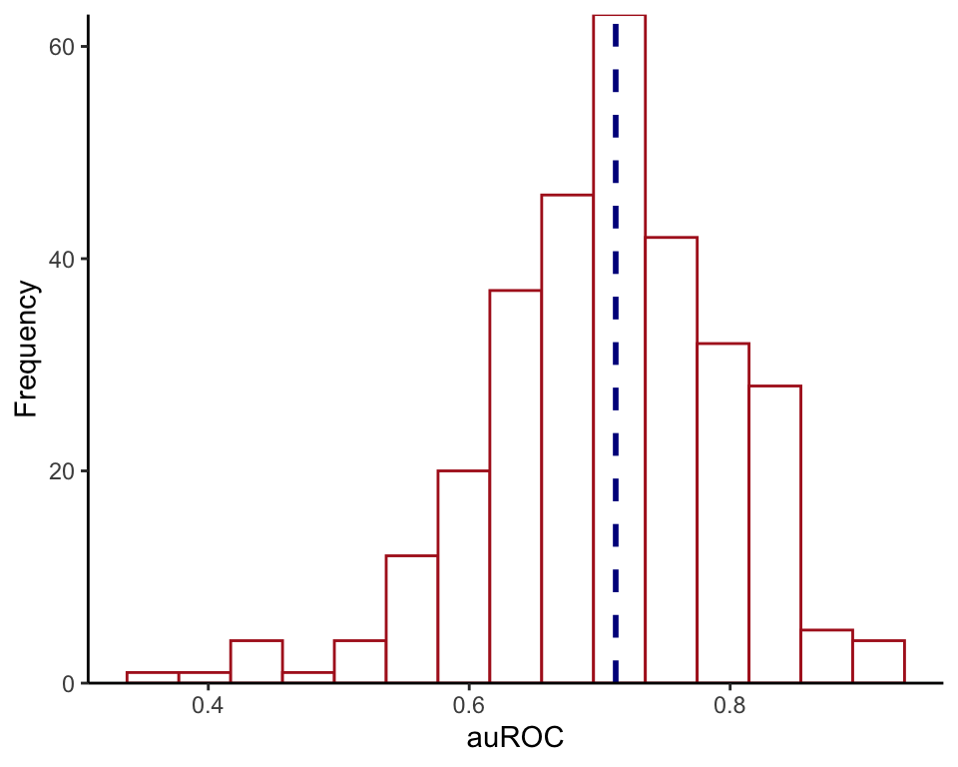
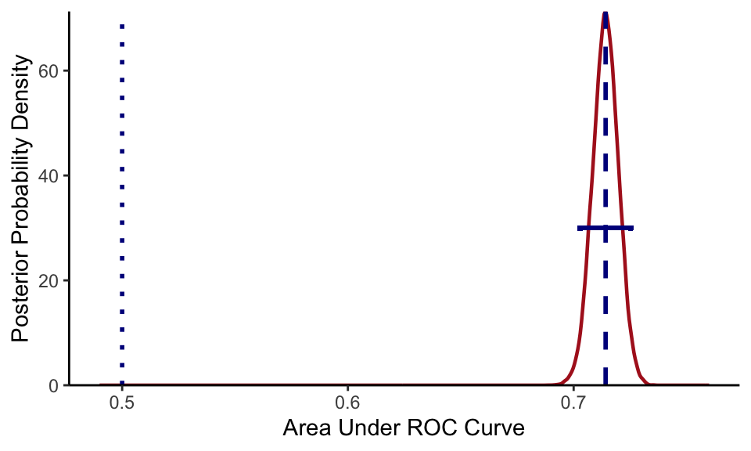
Model Performance
Median auROC across all validation sets:
.71
95% CI [0.70-0.73]
> .95 probability that model performance is better than chance based on posterior probability distribution
“Acceptable” level of performance
auROC between .7 and .8

Slide 26
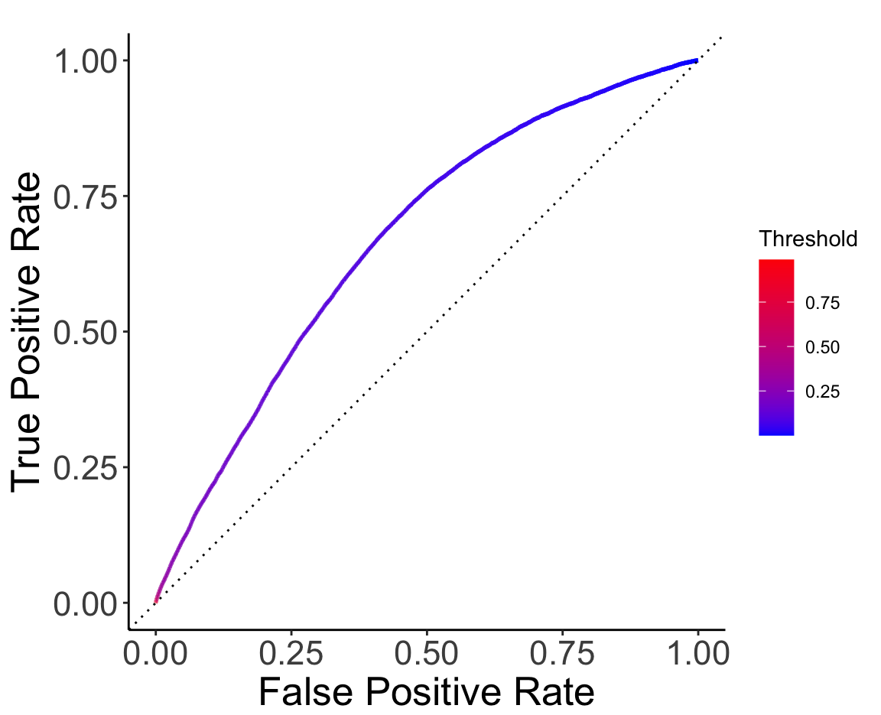
Model Performance
Notes:
Subgroups defined on personal individual characteristics divided to reflect coarse dichotomies of groups which experience relatively increased and decreased societal privilege

Slide 27
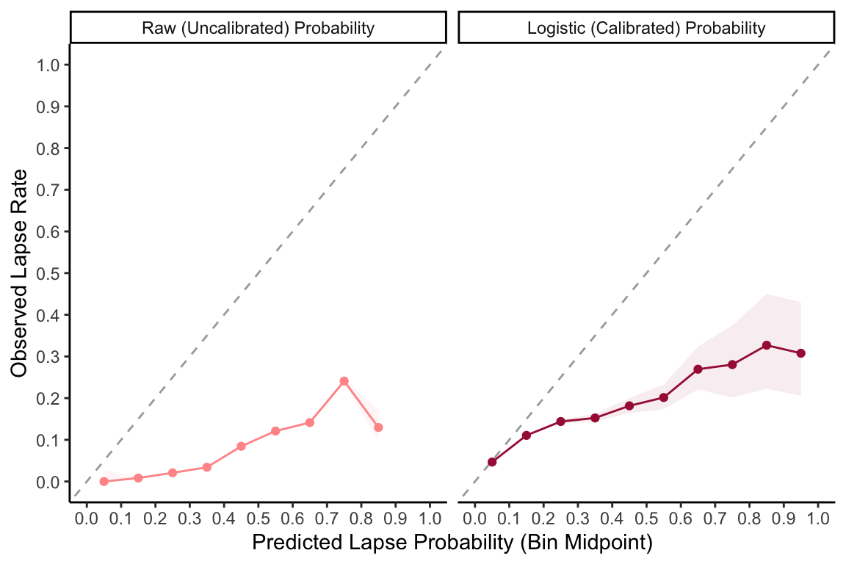
Model Calibration
Notes:
Subgroups defined on personal individual characteristics divided to reflect coarse dichotomies of groups which experience relatively increased and decreased societal privilege

Slide 28
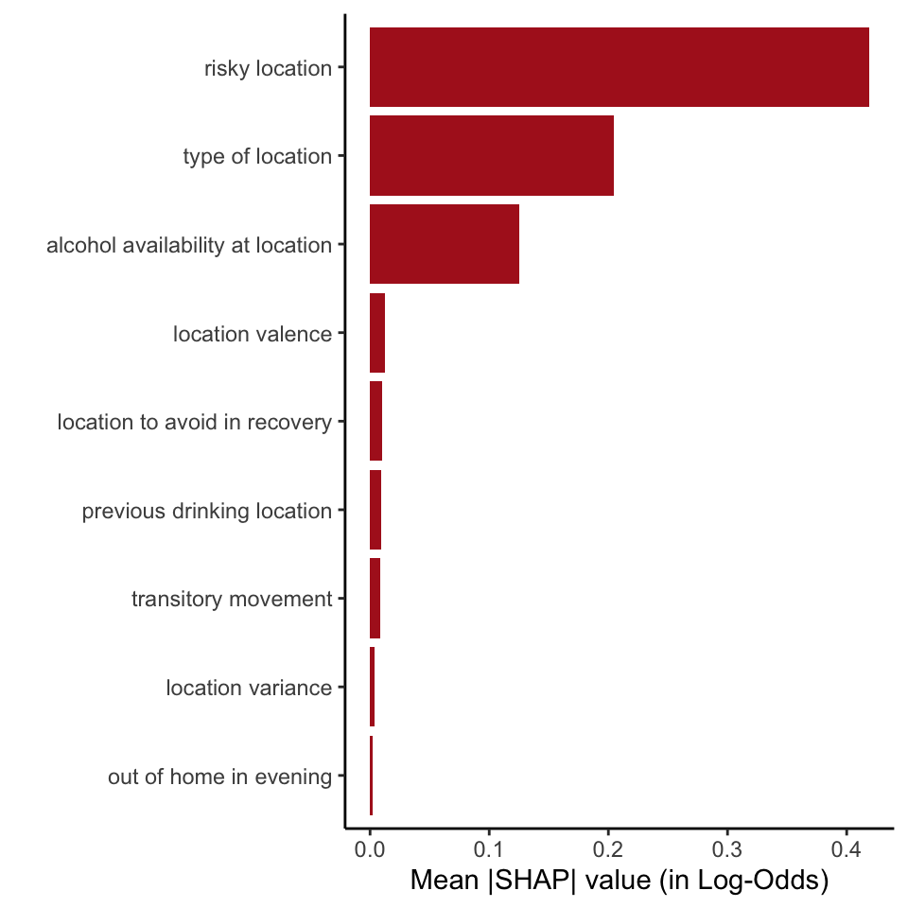
Feature Importance
Global feature importance revealed three highly contributing features to model performance:
Time spent at risky locations
Time spent at different types of locations
Time spent at locations with varying levels of alcohol availability
Notes:
Subgroups defined on personal individual characteristics divided to reflect coarse dichotomies of groups which experience relatively increased and decreased societal privilege

Slide 29
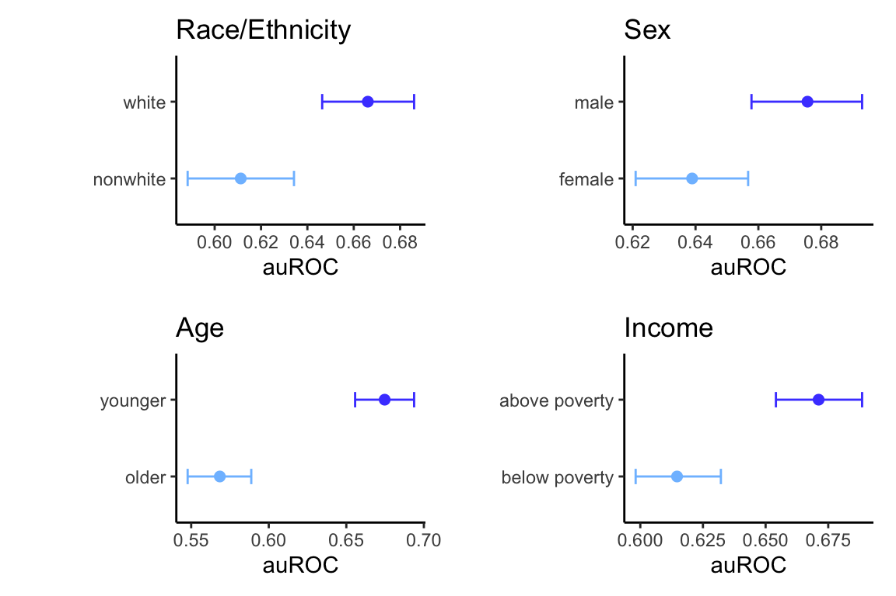
Algorithmic Fairness
All group comparisons were reliably different (probability > .95) across models
Benefits in performance:
White, non-Hispanic: .055 [.027-.084]
Male: .037 [.013-.060]
Younger: .107 [.079-.133]
Above poverty: .056 [.033-.078]
Notes:
Subgroups defined on personal individual characteristics divided to reflect coarse dichotomies of groups which experience relatively increased and decreased societal privilege

Slide 30
Conclusion
Summary, Limitations, & Future Directions

Slide 31
Model Performance
Geolocation data can predict future alcohol lapse in the next day with fair sensitivity and specificity
Still further improvement to be made in model performance
Bayesian model comparisons corroborated that this model performed unilaterally better than chance

Slide 32

Model Calibration
Even following calibration, our model overpredicts occurrence of lapses in our sample
Solutions:
Explore other calibration types (like beta calibration)
Examine feature set distribution (issue with unipolar features?)
This oversensitivity may not be an issue!
Maybe we don’t want this…
…but rather this!
Your risk of lapse is higher this week compared to last week. You have spent more time in risky places for your recovery.
You are at a low risk level of lapse today. Continue to spend less time in places where alcohol is available.
You are at a 92% chance of lapsing back to use today.
Notes:
Model calibration is the process of fine-tuning model predictions to more closely align with the true likelihood of a given outcome (improve trust in model predictions)

Slide 33
Feature Importance
Well-aligned with relapse prevention model:
High-risk situations as an immediate determinant to relapse
Potential to calculate these features without user input
Public map data to classify location types, consumer data to identify high liquor outlet density areas
Notes:
Subgroups defined on personal individual characteristics divided to reflect coarse dichotomies of groups which experience relatively increased and decreased societal privilege

Slide 34
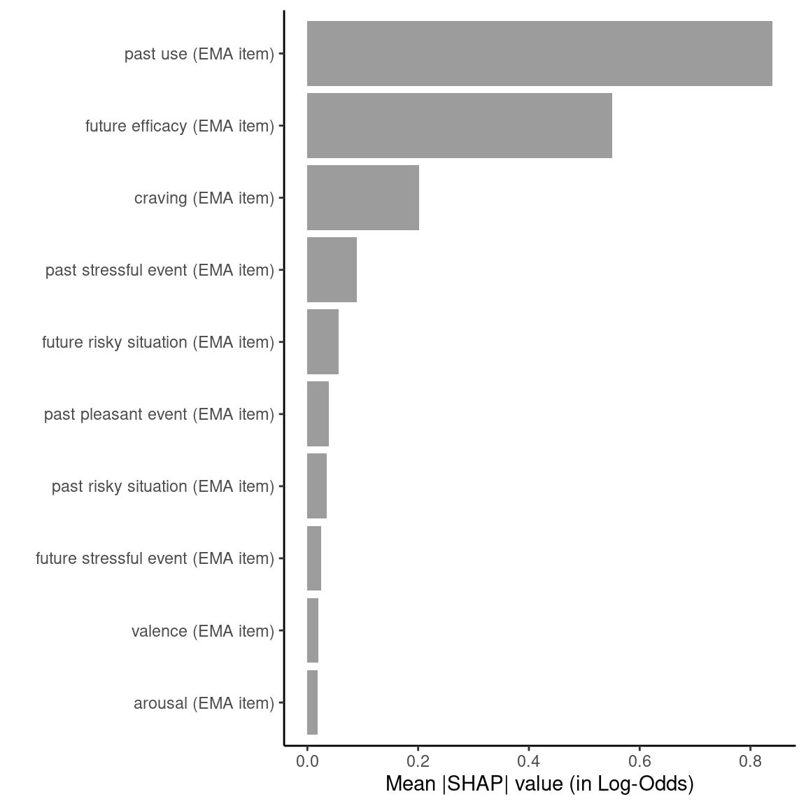
Feature Importance
Risky location
Type of location
Alcohol availability
Notes:
Subgroups defined on personal individual characteristics divided to reflect coarse dichotomies of groups which experience relatively increased and decreased societal privilege

Slide 35
Model fairness
All models exhibited differential performance across subgroups of race/ethnicity, sex at birth, age, and income
Worse for non-white and/or Hispanic, female, and older participants, as well as those below the poverty line
Lack of representative data
Historical literature
Non-white and/or Hispanic participants represent 13% of total sample
Less observations for the model to learn from = poorer predictive accuracy
N male = 74, N female = 72
AUD theory largely built on research on the experiences of, predominantly white, men
Features may not be as salient predictors for lapse for women
Notes:
Outside of recruiting a more diverse sample in future studies, one potential solution is to synthetically up-sample cases of the minority class (in this case, non-white participants) such that the model has more data on which to base its predictions
If maintaining a top-down approach to feature selection from the literature is a primary goal, more research will need to be done to create a better understanding of AUD experiences and recovery for specific groups who have historically been under-studied in this area
Alternatively, bottom-up approaches, such as allowing an algorithm to identify patterns in the data that are most predictive of lapse, may get around issues of bringing in biased features from the literature.
While it is important to consider ways to remedy this in our model so that it may be able to be equitably used in the real-world, it is also important to note that the goal of this work is not to suggest that quantitative definitions of fairness are sufficient to fix deeply rooted issues of societal injustice

Slide 36
Limitations and future directions
Model only has a fair level of performance
A simple strategy to improve this is to explore additional features
More rigorous model comparison
Current comparison against chance performance – develop baseline model
Closer examination of important features
Break apart global feature importance and examine local feature importance
Integration of most predictive features with ecological momentary assessment (EMA)-based model
Optimize development of a continuous risk monitoring system in recently funded grant (1R01AA031762-01)
Notes:
This study is an important step forward in building a model using geolocation data to predict next-day lapse back to drinking in individuals with a diagnosis of AUD and a recovery goal of abstinence. However, there are several limitations to this work

Slide 37
Conclusion
It is feasible to predict lapse with a fair level of accuracy using geolocation data, suggesting that geolocation data is a viable supplement for a continuous risk prediction monitoring system.
However, our model demonstrates differential performance across subgroups.
Moving forward, additional risk-relevant features will be added to the model to improve prediction and the final model will be evaluated.

Slide 38
Thank you!

Slide 39
References
Calling, S., Ohlsson, H., Sundquist, J., Sundquist, K., & Kendler, K. S. (2019). Socioeconomic status and alcohol use disorders across the lifespan: A co-relative control study. PloS one, 14(10), e0224127.
Davis, C. N., & O’Neill, S. E. (2022). Treatment of alcohol use problems among rural populations: a review of barriers and considerations for increasing access to quality care. Current Addiction Reports, 9(4), 432-444.
Doryab, A., Villalba, D. K., Chikersal, P., Dutcher, J. M., Tumminia, M., Liu, X., ... & Dey, A. K. (2019). Identifying behavioral phenotypes of loneliness and social isolation with passive sensing: statistical analysis, data mining and machine learning of smartphone and fitbit data. JMIR mHealth and uHealth, 7(7), e13209.
Epstein, D. H., Tyburski, M., Craig, I. M., Phillips, K. A., Jobes, M. L., Vahabzadeh, M., ... & Preston, K. L. (2014). Real-time tracking of neighborhood surroundings and mood in urban drug misusers: application of a new method to study behavior in its geographical context. Drug and alcohol dependence, 134, 22-29.
Foulds, J. R., Islam, R., Keya, K. N., & Pan, S. (2020, April). An intersectional definition of fairness. In 2020 IEEE 36th International Conference on Data Engineering (ICDE) (pp. 1918-1921). IEEE.
Gustafson, D. H., McTavish, F. M., Chih, M. Y., Atwood, A. K., Johnson, R. A., Boyle, M. G., ... & Shah, D. (2014). A smartphone application to support recovery from alcoholism: a randomized clinical trial. JAMA psychiatry, 71(5), 566-572.
Heller, A. S., Shi, T. C., Ezie, C. C., Reneau, T. R., Baez, L. M., Gibbons, C. J., & Hartley, C. A. (2020). Association between real-world experiential diversity and positive affect relates to hippocampal–striatal functional connectivity. Nature Neuroscience, 23(7), 800-804.
Janak, P. H., & Chaudhri, N. (2010). The potent effect of environmental context on relapse to alcohol-seeking after extinction. The open addiction journal, 3, 76.
Jonathan, P., Krzanowski, W. J., & McCarthy, W. V. (2000). On the use of cross-validation to assess performance in multivariate prediction. Statistics and Computing, 10, 209-229.
Kuhn, M., & Johnson, K. (2013). Applied predictive modeling (Vol. 26, p. 13). New York: Springer.
Kwan, M. P., Wang, J., Tyburski, M., Epstein, D. H., Kowalczyk, W. J., & Preston, K. L. (2021). Uncertainties in the geographic context of health behaviors: A study of substance users’ exposure to psychosocial stress using GPS data. In Uncertainty and Context in GIScience and Geography (pp. 47-66). Routledge.
LeCocq, M. R., Randall, P. A., Besheer, J., & Chaudhri, N. (2020). Considering drug-associated contexts in substance use disorders and treatment development. Neurotherapeutics, 17(1), 43-54.
Lundberg, S. M., & Lee, S. I. (2017). A unified approach to interpreting model predictions. Advances in neural information processing systems, 30.
Marlatt, G. A., & Donovan, D. M. (Eds.). (2007). Relapse prevention: Maintenance strategies in the treatment of addictive behaviors. Guilford press.
McKay, J. R., & Hiller-Sturmhöfel, S. (2011). Treating alcoholism as a chronic disease: approaches to long-term continuing care. Alcohol Research & Health, 33(4), 356.
Mennis, J., Stahler, G. J., & Mason, M. J. (2016). Risky substance use environments and addiction: a new frontier for environmental justice research. International journal of environmental research and public health, 13(6), 607.
Moos, R. H., & Moos, B. S. (2006). Rates and predictors of relapse after natural and treated remission from alcohol use disorders. Addiction, 101(2), 212-222.
Raugh, I. M., James, S. H., Gonzalez, C. M., Chapman, H. C., Cohen, A. S., Kirkpatrick, B., & Strauss, G. P. (2020). Geolocation as a digital phenotyping measure of negative symptoms and functional outcome. Schizophrenia bulletin, 46(6), 1596-1607.
SAMHSA, Center for Behavioral Health Statistics and Quality. 2022 National Survey on Drug Use and Health. Table 5.32A – Received substance use treatment in past year: among people aged 12 and older; by age group and past year drug use disorder, past year alcohol use disorder, past year drug and alcohol use disorder, and past year substance use disorder, numbers in thousands, 2021 and 2022. [cited 2024 May 2]. Available from: https://samhsa.gov/data/sites/default/files/reports/rpt42728/NSDUHDetailedTabs2022/NSDUHDetailedTabs2022/NSDUHDetTabsSect5pe2022.htm?s=5.32&#tab5.32a
SAMHSA, Center for Behavioral Health Statistics and Quality. 2022 National Survey on Drug Use and Health. Table 5.32B – Received substance use treatment in past year: among people aged 12 and older; by age group and past year drug use disorder, past year alcohol use disorder, past year drug and alcohol use disorder, and past year substance use disorder, percentages, 2021 and 2022. [cited 2024 May 2]. Available from: https://samhsa.gov/data/sites/default/files/reports/rpt42728/NSDUHDetailedTabs2022/NSDUHDetailedTabs2022/NSDUHDetTabsSect5pe2022.htm?s=5.32&#tab5.32b
SAMHSA, Center for Behavioral Health Statistics and Quality. 2022 National Survey on Drug Use and Health. Table 5.1A – Substance use disorder for specific substances in past year: among people aged 12 and older; by age group, numbers in thousands, 2021 and 2022. [cited 2024 May 2]. Available from: https://samhsa.gov/data/sites/default/files/reports/rpt42728/NSDUHDetailedTabs2022/NSDUHDetailedTabs2022/NSDUHDetTabsSect5pe2022.htm?s=5.1&#tab5.1a
Scott, J., Danos, D., Collins, R., Simonsen, N., Leonardi, C., Scribner, R., & Herd, D. (2020). Structural racism in the built environment: Segregation and the overconcentration of alcohol outlets. Health & place, 64, 102385.
Shin, J., & Bae, S. M. (2023). A systematic review of location data for depression prediction. International Journal of Environmental Research and Public Health, 20(11), 5984.
Sliedrecht, W., Roozen, H., de Waart, R., Dom, G., & Witkiewitz, K. (2022). Variety in alcohol use disorder relapse definitions: Should the term “relapse” be abandoned?. Journal of Studies on Alcohol and Drugs, 83(2), 248-259.
Stahler, G. J., Mennis, J., & Baron, D. A. (2013). Geospatial technology and the “exposome”: new perspectives on addiction. American journal of public health, 103(8), 1354-1356.
Stillman, M. A., & Sutcliff, J. (2020). Predictors of relapse in alcohol use disorder: Identifying individuals most vulnerable to relapse. Addiction and Substance Abuse, 1(1), 3-8.
Vaeth, P. A., Wang‐Schweig, M., & Caetano, R. (2017). Drinking, alcohol use disorder, and treatment access and utilization among US racial/ethnic groups. Alcoholism: Clinical and Experimental Research, 41(1), 6-19.
Walton, M. A., Blow, F. C., Bingham, C. R., & Chermack, S. T. (2003). Individual and social/environmental predictors of alcohol and drug use 2 years following substance abuse treatment. Addictive behaviors, 28(4), 627-642.
Walton, M. A., Reischl, T. M., & Ramanathan, C. S. (1995). Social settings and addiction relapse. Journal of Substance Abuse, 7(2), 223-233.
Wang, A., Ramaswamy, V. V., & Russakovsky, O. (2022, June). Towards intersectionality in machine learning: Including more identities, handling underrepresentation, and performing evaluation. In Proceedings of the 2022 ACM Conference on Fairness, Accountability, and Transparency (pp. 336-349).
Wisniewski, J., & Biecek, P. (2022). fairmodels: a Flexible Tool for Bias Detection, Visualization, and Mitigation in Binary Classification Models. R J., 14(1), 227-243.
Witbrodt, J., Mulia, N., Zemore, S. E., & Kerr, W. C. (2014). Racial/ethnic disparities in alcohol‐related problems: Differences by gender and level of heavy drinking. Alcoholism: Clinical and Experimental Research, 38(6), 1662-1670.
Witkiewitz K, Marlatt GA. Relapse prevention for alcohol and drug problems: that was Zen, this is Tao. Am Psychol. 2004 May-Jun;59(4):224-35.
Wyant, K., Sant'Ana, S. J., Fronk, G., & Curtin, J. J. (2023). Machine learning models for temporally precise lapse prediction in alcohol use disorder. PsyArXiv. September, 27.

Slide 40
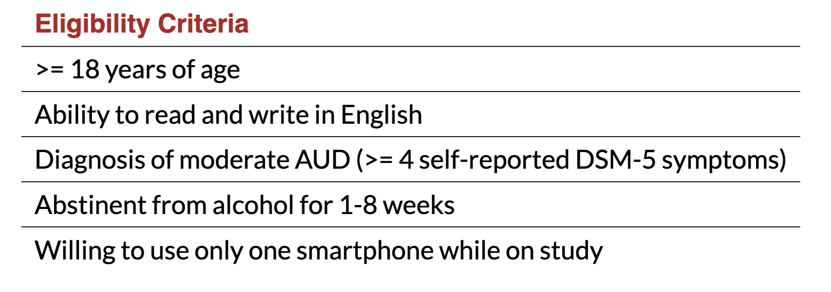
Participant eligibility criteria
Notes:
Participants completed a baseline measure of demographics and other constructs relevant to lapse at the screening visit, which will be used both for model building and for fairness assessments

Slide 41
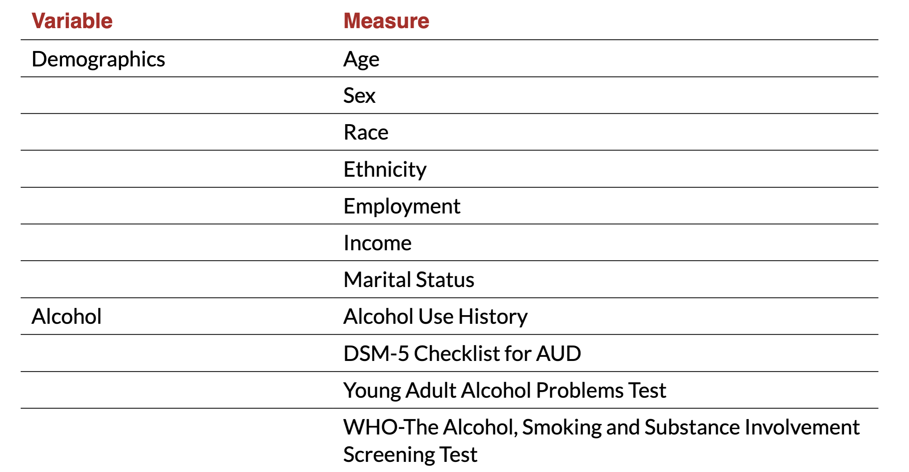
Measures: participant characteristics
Notes:
Participants completed a baseline measure of demographics and other constructs relevant to lapse at the screening visit, which will be used both for model building and for fairness assessments

